Slide 1
The Memory
14
Hierarchy

Slide 2
This is a Pyramid Scheme
But this knowledge is a safe investment.

Slide 3
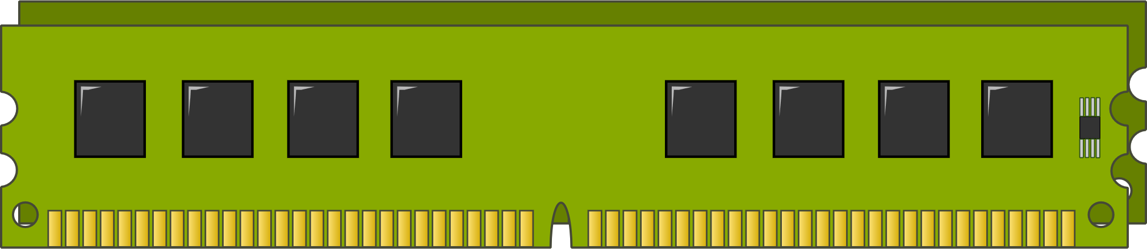

Wanting Moore and Moore
Processors and memory work together but improve at different rates.
Memory was initially faster than CPU, but its innovation was slower.
10000
Innovation starts to slow
1000
100
10
Throughput
1
The CPU overtakes
memory performance
0.1
0.01
1950
1960
1970
1980
1990
2000
2010
2020

Slide 4

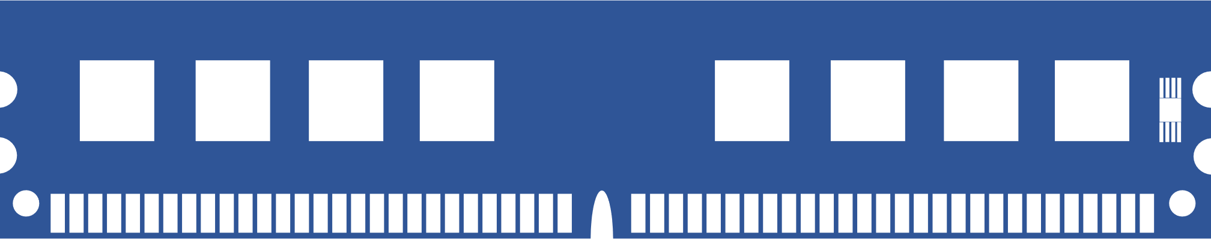
Cost of DRAM/Disk in 2020
8GiB $35 - 70
16GiB $70 - 100
32GiB $140 - 300
1TiB $50 – 80
8TiB $200 - $300
16TiB $400 - 500
nanoseconds
milliseconds

Slide 5
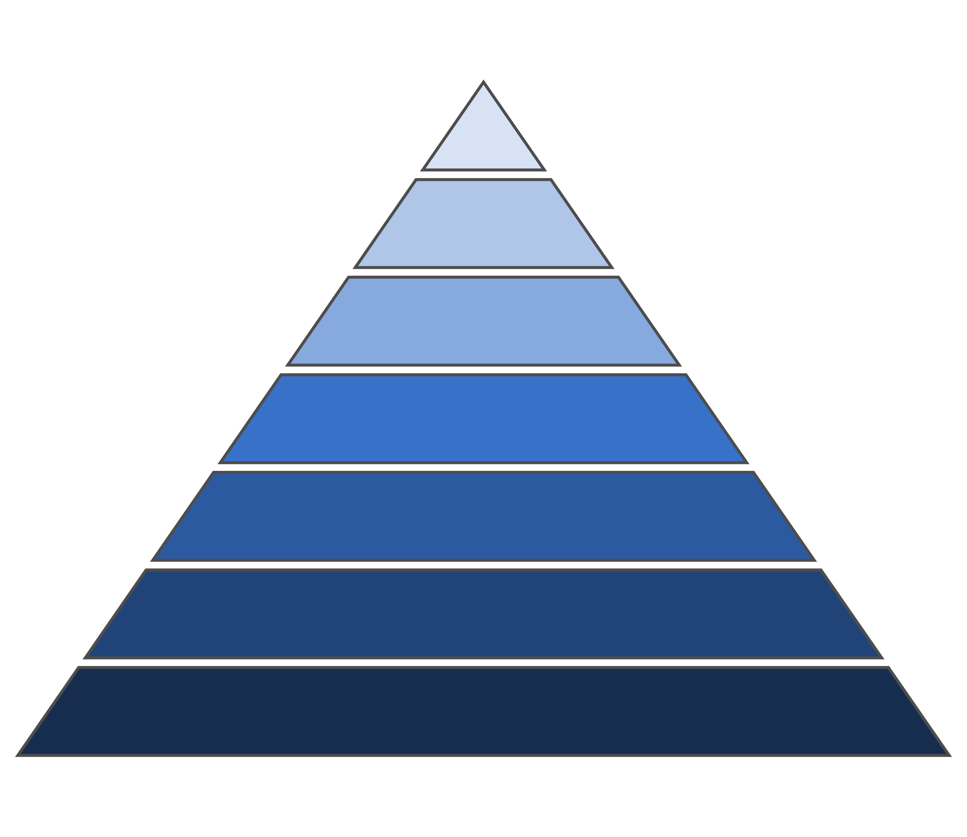


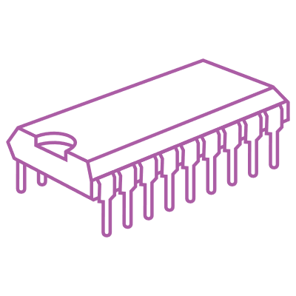
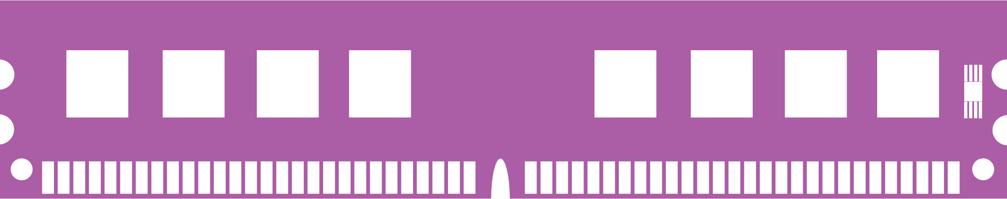





The memory hierarchy
Registers
Faster,
Denser
Expensive
L1 Cache
L2 Cache
Cheaper,
Slower,
Larger
(DRAM) Main Memory
Local Disk
Distributed Storage
(Don’t forget it!) Tape

Slide 6



The hierarchy of speed
A “cache” is used to hold
useful data closer than
main memory to
improve speed.
Registers
Faster,
Denser
Expensive
L1 Cache
DRAM is simply
too slow
L2 Cache
Cheaper,
Slower,
Larger
(DRAM) Main Memory
Local Disk
Distributed Storage
(Don’t forget it!) Tape

Slide 7
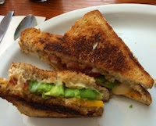
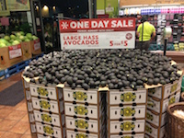
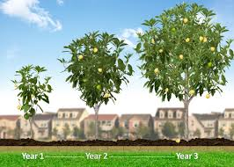

Memory Hierarchy: Core 2 Duo
SRAM
Static Random Access Memory
DRAM
Dynamic Random Access Memory
Not drawn to scale
~4 MB
~8 GB
~500 GB
L1
I-cache
L2 unified cache
Main Memory
Disk
32 KB
CPU
Reg
L1
D-cache
Throughput:
16 B/cycle
8 B/cycle
2 B/cycle
1 B/30 cycles
Latency:
3 cycles
14 cycles
100 cycles
millions
Miss Penalty
(latency)
33x
Miss Penalty
(latency)
10,000x

Slide 8
Memory Caching
Cache: Another thing us teachers could really use more of.

Slide 9

Experiment: Scientific Maths
#include <stdlib.h> // for malloc
#define LIMIT (2048 * 10)
int main(void) {
int i, j;
int* src[LIMIT];
int* dst[LIMIT];
for (i = 0; i < LIMIT; i++) {
src[i] = malloc(sizeof(int) * LIMIT);
dst[i] = malloc(sizeof(int) * LIMIT);
}
for (j = 0; j < LIMIT; j++) {
for (i = 0; i < LIMIT; i++) {
dst[j][i] = src[j][i];
}
}
return 0;
}
#include <stdlib.h> // for malloc
#define LIMIT (2048 * 10)
int main(void) {
int i, j;
int* src[LIMIT];
int* dst[LIMIT];
for (i = 0; i < LIMIT; i++) {
src[i] = malloc(sizeof(int) * LIMIT);
dst[i] = malloc(sizeof(int) * LIMIT);
}
for (j = 0; j < LIMIT; j++) {
for (i = 0; i < LIMIT; i++) {
dst[i][j] = src[i][j];
}
}
return 0;
}
> time ./locality-test-A
real 0m1.803s
user 0m1.123s
sys 0m0.677s
> time ./locality-test-B
real 0m20.374s
user 0m19.429s
sys 0m0.898s

Slide 10
Practical Performance
Caching is necessary for the utility of computers.
  The CPU/Memory gap increases (The Memory Wall)
In order to actually use these fast CPUs, we need to improve the apparent speed of RAM.
  Programs use memory a whole lot.
  The bottleneck would grind performance to the point where CPUs cannot improve.
“That’s a nice CPU you have there… it’d be
terrible if something were to happen to it.”

Slide 11



The problem: data is faaaaar away
Let’s say you want to read a book.
You check it out of the library.
  You have to go there.
  Find the book.
  Maybe take the bus back.
    Wait in traffic.
Now it sits on your desk.
  As long as it is near you, it’s easy to access the information.
  Yet, if you need another book…
    You would take the book ALL THE WAY back!
    (bare with me)
?

Slide 12

Caching: Keeping things close
Let’s say you want to read a book.
  It’s not on your bookshelf.
So, still have to check it out of the library.
  You gotta go there. Find the book. Etc.
  Take the bus back.
Now it sits on your desk.
  As long as it is near you, it is easy to access the information.
  When we need another book… we put it aside.
    Maybe a bookshelf.
  The next time we need it, it will be nearby.
?

Slide 13
The metaphorical cache
The bookshelf is a cache.
  It holds information that you might want later.
It is [much] smaller than a library, but faster to retrieve things.
However, it is small. Placing a new book on the shelf may require taking an old book off.

Slide 14

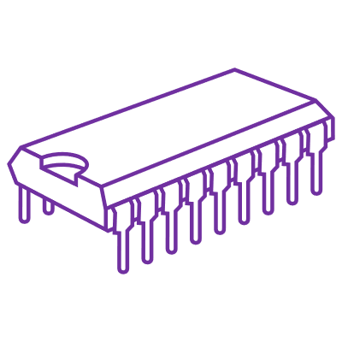
Memory cache (CPU)
RAM is the library. It is far away and getting stuff from there is slow.
To better handle the performance gap between the CPU and memory we add a smaller, fast memory near the CPU.
This is the CPU cache.

Slide 15

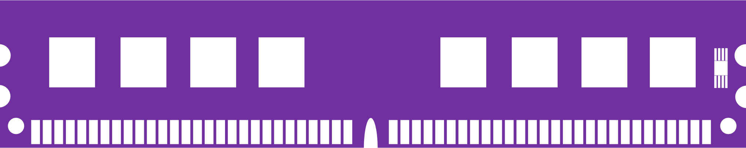
Data, the journey
When data is requested, the goal is to read a word into a CPU register.
The CPU first contacts the cache and asks if it has a copy.
  If it does… that is a cache hit, and, well, that was easy. Just copy that value into the register.
If it does not, this is a cache miss.
  It will then contact the next component in the memory hierarchy. (RAM)
Ram copies the value to cache, and the cache copies the value to the register.
mov (%rbx), %rax
%rax
?

Slide 16
Missing the mark
RAM
When the CPU requests memory in an empty cache, the data obviously won’t be available locally.
This is a compulsory miss, a “miss” due to the first access of a block of data.
  Also known as a “cold miss.”
These are, as they suggest, completely unavoidable.
  They always incur the high penalty associated with a memory read.
0
1
2
3
4
5
6
7
8
9
8
A
B
C
D
E
8
CPU Cache
8
%rax
?
mov (0x8), %rax

Slide 17
Hitting the target
RAM
When the CPU requests memory that happens to already be in the cache, the data is read locally (quickly).
This is a cache hit.
  Your best-case scenario.
These avoid having to communicate at all with memory.
  No penalty taken for reading/writing to memory.
  Very cheap in terms of time.
0
1
2
3
4
5
6
7
8
9
A
B
C
D
E
8
8
CPU Cache
8
%rax
?
mov (0x8), %rax

Slide 18
A cache half full…
As the CPU requests memory, the cache will fill to satisfy each compulsory miss.
When it fills up completely, it will have no further room for the next miss.
On a miss, it requests the data from memory.
  Yet, where does it go?? We must remove one.
This is a capacity miss. The memory requirements of the program are larger than the cache.
RAM
0
1
2
3
4
5
6
7
8
9
8
A
B
C
D
E
4
6
C
1
8
E
CPU Cache
8
%rax
?
mov (0x8), %rax

Slide 19
Looking closer…
It is difficult to know what block of data to omit from this cache on such a miss.
  However we can exploit the common locality patterns of programs to improve our cache.
There is temporal locality: accessed data is likely to be used again in near future.
  This is what caches generally capture.
However, spatial locality is also likely: data is often grouped together.
  When we access a struct field, we will often access another which is nearby in memory.
RAM
0
1
2
3
4
5
6
7
8
9
A
B
C
D
E
4
6
C
1
8
CPU Cache
%rax
8

Slide 20
Exploring space…
We would like to keep data that is adjacent in memory in the cache, together, at the same time.
To do this, we “hash” the address. This is used to determine the cache slot.
  Just a fancy way to say: we divide the address by the cache size and use the remainder.
Every 0th block, 1st block, 2nd block, etc.
The 5th block (in this example) goes to the 0 slot, the 6th goes to the 1 slot, and so on.
RAM
0
1
2
3
4
5
6
7
8
9
A
B
C
D
E
0
1
2
3
4
CPU Cache
%rax
8

Slide 21
Direct and to the point…
Let’s read addresses 3, 4, 5, 6, and 7 (in that order) from memory.
Reading address 8 next incurs a capacity miss, but it evicts the address that is furthest away from the others.
  This type of cache is good for programs that read through data sequentially.
  That is because such programs will always remove the least recently used block on a miss, as shown here.
Because every address has a specific cache slot, this is called a direct-mapped cache.
RAM
0
1
2
3
3
4
4
5
5
6
6
7
7
8
8
9
A
B
C
D
E
0
1
2
3
4
5
6
7
3
4
8
CPU Cache
%rax
8

Slide 22
Missing your connection…
Let’s consider an antagonist pattern.
  What is the worst case for this cache?
If we read every 5th address in our memory in order, we would overwhelm our direct-mapped cache.
  Let’s access 0, 5, A in that order.
Accessing address 0 is a compulsory miss.
  Address 5, however, is a miss.
  But our cache isn’t full!!
A miss that occurs even though your cache could fit the block is called a conflict miss.
RAM
0
0
1
2
3
4
5
5
6
7
8
9
A
A
B
C
D
E
0
1
2
3
4
5
A
0
CPU Cache
%rax
A

Slide 23
How big is that block?
Spatial locality is SO prevalent that it makes a whole lot of sense to pull more data than is requested.
  If we request a word (8 bytes) from memory, and we have a cache miss, let’s pull 8 words at a time (64 bytes).
Therefore, the blocks visualized to the right can have a size, called the block size.
  The bigger the block, the better spatial locality will become.
  However, the more time it takes to copy from memory and the higher penalty if you throw it away on a miss!
RAM
0
1
2
3
4
5
6
7
8
9
A
B
C
D
E
64 bytes
0
1
2
3
4
CPU Cache
%rax
8 bytes

Slide 24
Block size helps locality
When we request an address from our cache, we are requesting the block that contains that address.
  Here, Block 0 contains byte addresses 0x00 through 0x39. Block 1 is 0x40 to 0x79, etc.
Let’s request 64-bit words in order starting at address 0x40 (Block 1)
  There are 8 words in each cache block.
  Therefore, we have only one compulsory miss.
  And then we have 7 cache hits!!
If we request the ninth word, we will be at address 0x80 (and a compulsory miss.)
RAM
0
1
1
2
2
3
4
5
6
7
8
9
A
B
C
D
E
64 bytes
0
1
2
3
4
1
2
CPU Cache
%rax

Slide 25
Once again… A Tale of Two C… um… programs
#include <stdlib.h> // for malloc
#define LIMIT (2048 * 10)
int main(void) {
int i, j;
int* src[LIMIT];
int* dst[LIMIT];
for (i = 0; i < LIMIT; i++) {
src[i] = malloc(sizeof(int) * LIMIT);
dst[i] = malloc(sizeof(int) * LIMIT);
}
for (j = 0; j < LIMIT; j++) {
for (i = 0; i < LIMIT; i++) {
dst[j][i] = src[j][i];
}
}
return 0;
}
#include <stdlib.h> // for malloc
#define LIMIT (2048 * 10)
int main(void) {
int i, j;
int* src[LIMIT];
int* dst[LIMIT];
for (i = 0; i < LIMIT; i++) {
src[i] = malloc(sizeof(int) * LIMIT);
dst[i] = malloc(sizeof(int) * LIMIT);
}
for (j = 0; j < LIMIT; j++) {
for (i = 0; i < LIMIT; i++) {
dst[i][j] = src[i][j];
}
}
return 0;
}
SERIOUS
Allocates matrices.
(Array of arrays)
Copies one matrix to another.
(data itself is uninitialized.)
Iterates through column.
(Other code goes through row)
> time ./locality-test-A
real 0m1.803s
user 0m1.123s
sys 0m0.677s
> time ./locality-test-B
real 0m20.374s
user 0m19.429s
sys 0m0.898s

Slide 26
Once again… A Tale of Two C… um… programs
#include <stdlib.h> // for malloc
// We will look at a 4 by 4 matrix
int main(void) {
int i, j;
int* src[4];
int* dst[4];
for (i = 0; i < 4; i++) {
src[i] = malloc(sizeof(int) * 4);
dst[i] = malloc(sizeof(int) * 4);
}
for (j = 0; j < 4; j++) {
for (i = 0; i < 4; i++) {
dst[j][i] = src[j][i];
}
}
return 0;
}
We will simplify by looking at a 4x4 matrix.
  We want to get the addresses being used to see the access pattern. (Goes across row)
src[0]
0x80
0x84
0x88
0x8c
src[1]
0x90
0x94
0x98
0x9c
src[2]
0xa0
0xa4
0xa8
0xac
src[3]
0xb0
0xb4
0xb8
0xbc
0x80
0x84
0x88
0x8c
0x90
0x94
0x98
0x9c
0xa0
0xa4
src[0][0]
src[0][2]
src[1][0]
src[1][2]
src[2][0]
src[0][1]
src[0][3]
src[1][1]
src[1][3]

Slide 27
Once again… A Tale of Two C… um… programs
We will simplify by looking at a 4x4 matrix.
  Notice the different type of access pattern.
  (Goes down the column)
#include <stdlib.h> // for malloc
// We will look at a 4 by 4 matrix
int main(void) {
int i, j;
int* src[4];
int* dst[4];
for (i = 0; i < 4; i++) {
src[i] = malloc(sizeof(int) * 4);
dst[i] = malloc(sizeof(int) * 4);
}
for (j = 0; j < 4; j++) {
for (i = 0; i < 4; i++) {
dst[i][j] = src[i][j];
}
}
return 0;
}
src[0]
0x80
0x84
0x88
0x8c
src[1]
0x90
0x94
0x98
0x9c
src[2]
0xa0
0xa4
0xa8
0xac
src[3]
0xb0
0xb4
0xb8
0xbc
0x82
0xb4
0xa4
0x94
0x84
0xb0
0xa0
0x90
0x80
src[2][1]
src[0][1]
src[2][0]
src[0][0]
src[3][1]
src[1][1]
src[3][0]
src[1][0]

Slide 28
The Antagonist
One program reads words sequentially in memory (good spatial locality)
  The other reads each word as far apart as possible! (worst spatial locality)
Let’s look at making the matrices much larger! Let’s make each row span 256 Bytes. (4 blocks, which is the size of our cache!)
0x80
Miss
0x80
Miss
0x84
Hit
0x180
Miss
0x88
Hit
0x280
Miss
0x8c
Hit
0x380
Miss
0x90
Hit
0x84
Miss
0x94
Hit
0x184
Miss
RAM
0x98
Hit
0x284
Miss
0
1
2
3
Hit
Miss
This cache item holds 0x000, 0x100, 0x200, etc
0x9c
0x384
0xa0
Hit
0x88
Miss
0
1
2
3
0xa4
Hit
0x188
Miss
CPU Cache
(256 Bytes)
Cache size: 256B
64 bytes per block.
0xa8
Hit
0x288
Miss
0xac
0x388

Slide 29
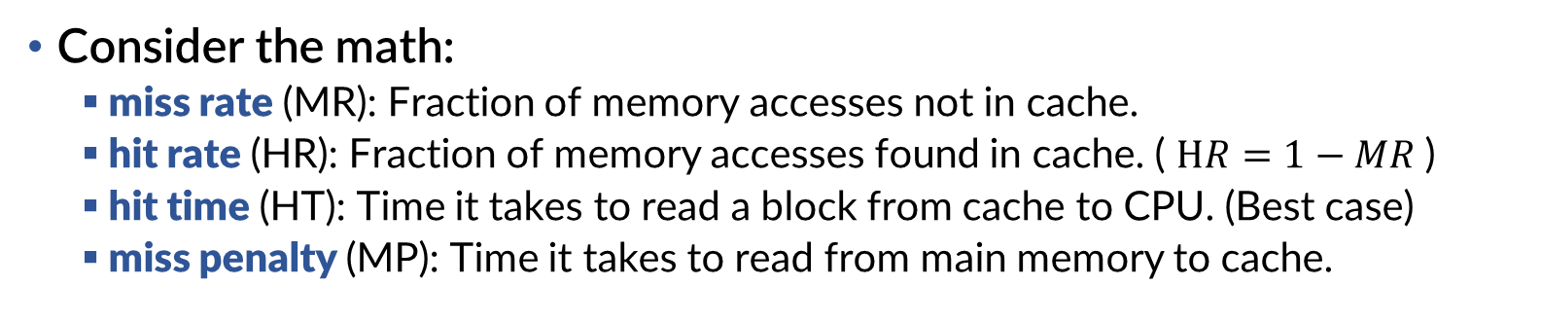
Cache Performance
  Why? Well…
  Our “slow” program effectively did not use cache, and it was 10 times slower.
Simply: Caches offer much faster accesses than DRAM.
  Perhaps 100s of times faster.
Recall that caches make computers practical.
Consider the math:
  miss rate (MR): Fraction of memory accesses not in cache.
  hit rate (HR): Fraction of memory accesses found in cache. ( $HR=1−MR$)
  hit time (HT): Time it takes to read a block from cache to CPU. (Best case)
  miss penalty (MP): Time it takes to read from main memory to cache.

Slide 30
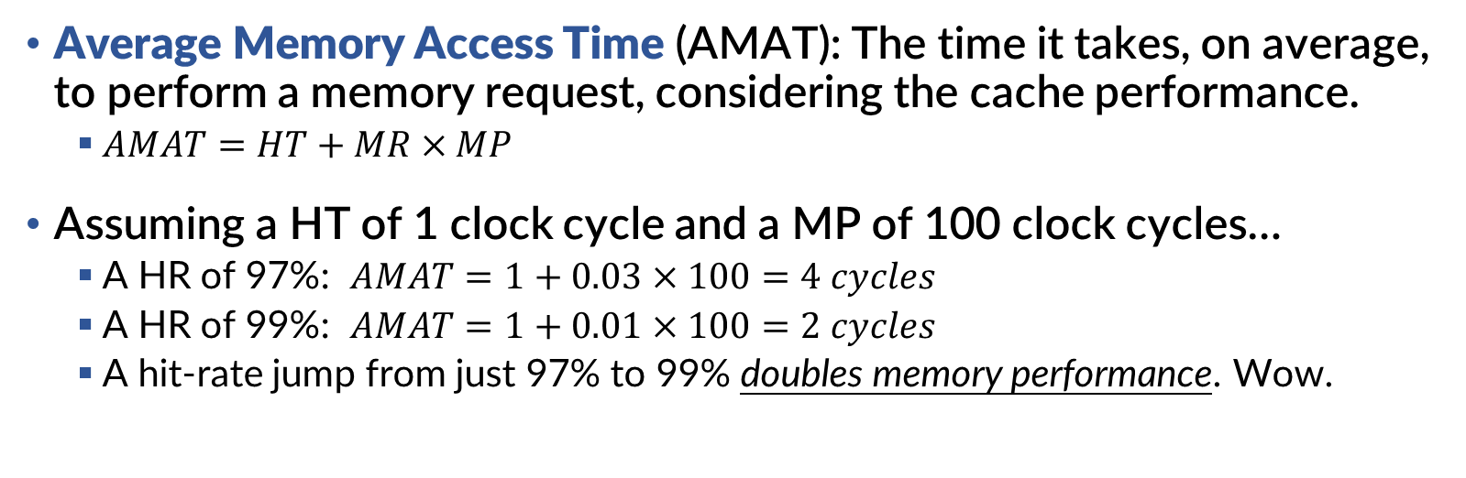
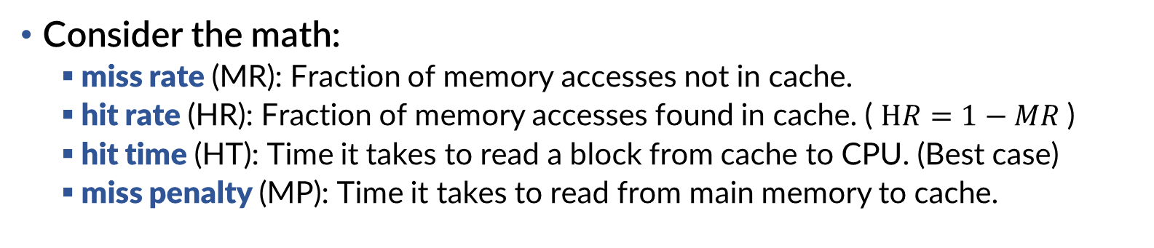
Cache Performance
Recall that caches make computers practical.
Consider the math:
  miss rate (MR): Fraction of memory accesses not in cache.
  hit rate (HR): Fraction of memory accesses found in cache. ( $HR=1−MR$)
  hit time (HT): Time it takes to read a block from cache to CPU. (Best case)
  miss penalty (MP): Time it takes to read from main memory to cache.
Average Memory Access Time (AMAT): The time it takes, on average, to perform a memory request, considering the cache performance.
  $AMAT=HT+MR×MP$
Assuming a HT of 1 clock cycle and a MP of 100 clock cycles…
  A HR of 97%: $AMAT=1+0.03×100=4 cycles$
  A HR of 99%: $AMAT=1+0.01×100=2 cycles$
  A hit-rate jump from just 97% to 99% doubles memory performance. Wow.

Slide 31
Cache Layout Summary
We have seen two types of cache layouts.
  A freeform cache: blocks go wherever. ¯\_(ツ)_/¯
    Also called a fully associative cache.
  A direct-mapped cache: blocks go into slots.
They have their own trade-offs, and as usual…
  We can have a hybrid approach!
Here, each cache slot has multiple bins.
  You only need to evict when you fill up the bins. Best of both worlds!
  Which do you evict? (Hmm… difficult choice.)
CPU Cache
(fully associative)
0
1
2
3
4
CPU Cache
(direct-mapped)
0
1
2
3
4
CPU Cache
(2-way associative)

Slide 32
Associativity
With an associative cache, the address determines the slot.
  Much like a direct-mapped cache.
  However, the slot has a number of bins.
  Any bin in the slot is viable for a block.
  The number of bins is the number of “ways”
    A direct-mapped cache is a 1-way cache.
When the cache determines if the block is in the cache already…
  It determines the slot.
  It scans every bin for a block tagged with that exact address.
  Therefore, the cache performance degrades as you increase the number of ways.
0
1
2
3
4
5
CPU Cache
(2-way associative)
0
1
2
CPU Cache
(4-way associative)

Slide 33
Another way of viewing it
CPU Cache
(fully associative)
CPU Cache
(direct-mapped)
(1-way associative)
All have the same size, so…
0
0
1
2
3
4
5
6
7
On a fully associative cache all blocks belong to the same set
On a direct-mapped cache all blocks belong to a different set
0
1
2
3
On a n-way associative cache n blocks belong to the same set
CPU Cache
(2-way associative)

Slide 34
Mapping
WT F…Cache!?

Slide 35
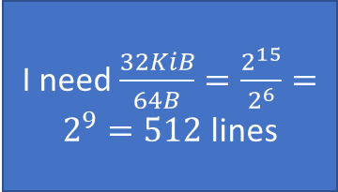
Sooo… exactly what can go where?
64B
Given a memory address, in which set does it go?
How many sets are there?
Let’s start by defining a cache size
  32KiB
How many cache lines do you need?
  Well it depends on the size of each cache line
    # Cache line? # Cache row? # Block? # bins?
  Let’s use: 64B!
I need $\frac{32KiB}{64B}=\frac{2^{15}}{2^{6}}=2^{9}=512$ lines

Slide 36

Sooo… exactly what can where?
64B
Let’s start by defining a cache size
  32KiB
How many cache rows do you need?
  Well it depends on the size of each row
  Let’s use: 64B!
Decrease the size
  +rows, + (but faster) memory access, -locality
Increase the size
  -rows, -(but slower) memory access, +locality
I need $\frac{32KiB}{64B}=\frac{2^{15}}{2^{6}}=2^{9}=512$ rows

Slide 37
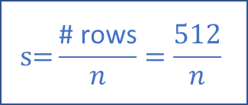

How many sets
The number of sets depends on the associativity
  Remember we have a fixed amount of rows!
For fully associative (easy) we have 1 set ☺
For n-way associative cache we need some maths:
  n-way associative means we divide the lines in groups of n-elements
0
…
s-1
So how many sets?
Each column (set) has n rows
$$\text{s}\text{=}\frac{\text{\# }\text{rows}}{n}=\frac{512}{n}$$
Still $512$ rows!

Slide 38

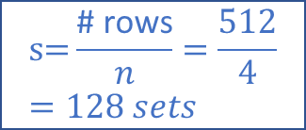
How many sets
If we apply this to a 4-way associative cache
0
…
127
So how many sets?
Each column (set) has 4 rows
$$\text{s}\text{=}\frac{\text{\# }\text{rows}}{n}=\frac{512}{4}=128 sets$$
Still $512$ rows!

Slide 39
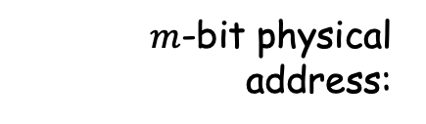
Address Manipulation
Request from CPU:
$n$-bit virtual address
Access PT:
Virtual Page Number
Page offset
TRANSLATION
$m$-bit physical address:
Physical Page Number
Page offset
Split to access cache:
Cache Tag
Set Index
Offset
Notes:
Need to restart instruction.
Soft and hard page faults.

Slide 40
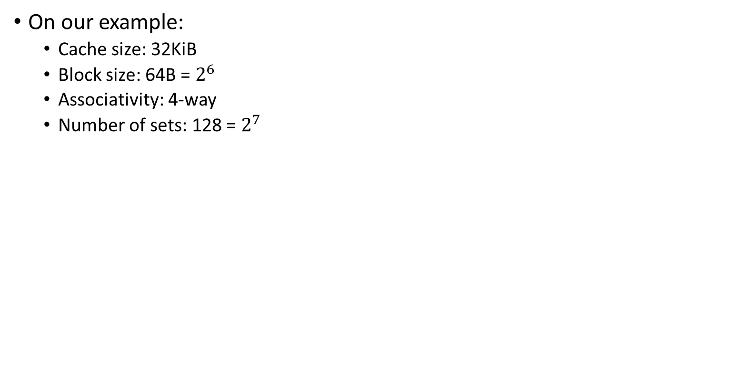
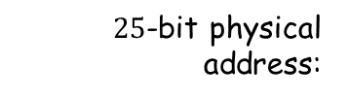
Using our example
On our example:
  Cache size: 32KiB
  Block size: 64B = $2^{6}$
  Associativity: 4-way
  Number of sets: 128 = $2^{7}$
$25$-bit physical address:
Physical Page Number
Page offset
Split to access cache:
Cache Tag
Set Index
Offset
12 bits
7 bits
6 bits
TAG | Set | valid | Data
0xFFF | 0 | 0 | (64B of data)
0xFFF | 0 | 1 | (64B of data)
0xFFF | 1 | 1 | (64B of data)
0x123 | 1 | 1 | (64B of data)
0x456 | 42 | 1 | (64B of data)
0xFFF | 42 | 1 | (64B of data)
Only showing 2 blocks per set (slide space)
Notes:
Need to restart instruction.
Soft and hard page faults.

Slide 41
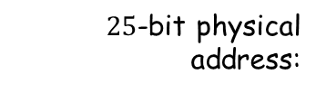
Using our example
TAG | Set | valid | Data
0x000 | 0 | 0 | (64B of data)
0xFFF | 0 | 1 | (64B of data)
0xFFF | 1 | 1 | (64B of data)
0x123 | 1 | 1 | (64B of data)
0x456 | 42 | 1 | (64B of data)
0xFFF | 42 | 1 | (64B of data)
Hit!
$25$-bit physical address:
111111111111000000
0000000
Split to access cache:
0xFFF
0
0
12 bits
7 bits
6 bits
Notes:
Need to restart instruction.
Soft and hard page faults.

Slide 42
Using our example
TAG | Set | valid | Data
0x000 | 0 | 0 | (64B of data)
0xFFF | 0 | 1 | (64B of data)
0xFFF | 1 | 1 | (64B of data)
0x123 | 1 | 1 | (64B of data)
0x456 | 42 | 1 | (64B of data)
0xFFF | 42 | 1 | (64B of data)
Miss!
$25$-bit physical address:
000000000000000000
0000000
Split to access cache:
0x000
0
0
12 bits
7 bits
6 bits
Notes:
Need to restart instruction.
Soft and hard page faults.

Slide 43
Using our example
TAG | Set | valid | Data
0x000 | 0 | 0 | (64B of data)
0xFFF | 0 | 1 | (64B of data)
0xFFF | 1 | 1 | (64B of data)
0x123 | 1 | 1 | (64B of data)
0x456 | 42 | 1 | (64B of data)
0xFFF | 42 | 1 | (64B of data)
Hit!
$25$-bit physical address:
000100100011000000
1000000
Split to access cache:
0x123
1
0
12 bits
7 bits
6 bits
Notes:
Need to restart instruction.
Soft and hard page faults.

Slide 44
Using our example
TAG | Set | valid | Data
0x000 | 0 | 0 | (64B of data)
0xFFF | 0 | 1 | (64B of data)
0xFFF | 1 | 1 | (64B of data)
0x123 | 1 | 1 | (64B of data)
0x456 | 42 | 1 | (64B of data)
0xFFF | 42 | 1 | (64B of data)
Miss!
$25$-bit physical address:
101010101010010101
0000000
Split to access cache:
0xAAA
42
0
12 bits
7 bits
6 bits
Notes:
Need to restart instruction.
Soft and hard page faults.

Slide 45
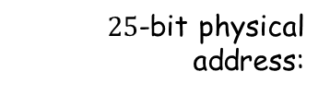
Offset
TAG | Set | valid | Data
0x000 | 0 | 0 | (64B of data)
0xFFF | 0 | 1 | (64B of data)
0xFFF | 1 | 1 | (64B of data)
0x123 | 1 | 1 | (64B of data)
0x456 | 42 | 1 | (64B of data)
0xFFF | 42 | 1 | (64B of data)
Hit!
63 | 62 | 61 | … | 5 | 4 | 3 | 2 | 1 | 0
0xF5 | 0x32 | 0x45 | … | 0xFF | 0xFE | 0x00 | 0x68 | 0x67 | 0x65
$25$-bit physical address:
111111111111000000
0000010
Split to access cache:
0xFFF
0
2
12 bits
7 bits
6 bits

Slide 46
Summary
The notion of storing data is a complicated one.
  Different technologies have different strengths (and costs)
  Often trade-off between:
    fast / small, expensive
    slow / big, cheap
  Hardware designs attempt to accommodate a variety of technologies.
    Often using fast/small memories to act as a “cache” for slower ones.
Caches can be arranged in several ways:
  Blocks go anywhere (fully-associative)
  Blocks go in particular slots (direct-mapped / 1-way associative)
  Hybrid: Blocks go to particular slots… but then can go in any bin in that slot.
Caches attempt to exploit temporal and spatial locality of programs.
  And even a slight improvement to hit rate can dramatically improve overall performance of a program!

